Slide 1


NIEM MILOPS DOMAIN
Issuance Document

Slide 2
Outline
Purpose / Bottom Line Up Front
Course of Actions
Proposed Recommendations

Slide 3
Purpose / bluf
As NIEM transitions to OASIS, the MILOPS Military Operation Mission Specific (MOMS) release & content will not be under NIEMOpen due to its restricted content. In order to codify Military Operations Domain, an authoritative document will benefit DOD.
Currently:
DODI 8320.07 states to consider NIEM for all new XML information exchanges.
NIEM is transitioning to an open standard and MILOPS has restricted content.
There is no document to support or provide procedures on the MILOPS content.
Actual Implementation:
DOD CIO does not enforce the 8320.07 policy and has not implemented a waiver program.
MILOPS restricted content must reside with a DOD repository and cannot be part of the NIEMOpen standard.
Result:
Services, CCMDS, and defense agencies simply state they consider NIEM first.
Lack of waiver process allows services, CCMDs, and defense agencies to not adopt DODI 8320.07 nor provide evidence of consideration.
NIEM is not being adopted / implemented across the DOD, limiting interoperability at the data level.
Adoption of NIEM across DOD, Services, CCMDS, & Defense Agencies is not enforced.

Slide 4
Proposed Recommendation
Near Term
Update & Strengthen DODI 8320.07 NIEM First Language
Publish a NIEM MILOPS CJCSI
Includes:
Referencing MOMs (how to access it; how to use it).
MILOPS content utilizing NIEM Open.
Mid Term
Publish CJCSM
Includes:
How to implement NIEMOpen and MOMS.
Waiver Process via JADC2 CFT and JCIDS.
Long Term
Request change to DISR to add NIEMOpen on the commercial standard list.
Implement the waiver program via JADC2 CFT and JCIDS.
Notes:
Near Term:
- First work the process to update the DODI NIEM language.
Currently it states to “consider NIEM”. Will work on changing this to “ b. In accordance with DoD CIO Memorandum, and except as required otherwise by law or
DOD policy, NIEM must be used for all information exchanges created. If NIEM does not meet the requirements than organizations must submit a waiver.”
- Then work on writing a CJCSI for MILOPS Domain referencing NIEM Open and MOMS content.
This will provide more specification / clarification to the DODI.
MILOPS Domain sponsors and manages the CJCSI as well as the waiver program.
Annual review after the first 2 years.
Republish after 5 years.
This would be CJCSI #6243.01 which will align with the interoperability CJCSIs 6200 series.
- In the CJCSI, we will reference that there will be a waiver program / process.
Mid Term:
- Once a CJCSI and the DODI have been complete. We will work on writing a CJCSM to provide guidance on how to implement MILOPS content using NIEM.
- In the CJCSM, we ill include the process for providing a statement of use of NIEM or the waiver process.
Long Term:
- When NIEMOpen and its model, framework, and specifications become official standards within OASIS, NIST, …… we will submit NIEMOpen in the DISR.
- Enforce organizations when submitting data related capabilities to provide a statement of use of NIEM or a waiver.

Slide 5
BACK UP

Slide 6
Course of actions
Update DODI 8320.07 to reflect NIEM first language.
Publish a DODI that establishes policy for NIEM as a standard.
Publish a DODM that supplements the DODI and provides guidance on implementation of NIEM as a standard.
Publish NIEM MILOPS CJCSI
Establish policy on NIEM MILOPS and codify MILOPS content
Provides brief guidance on how to implement MILOPS content using NIEMOpen.
Publish NIEM MILOPS CJCSM
Establish policy on NIEM MILOPS and codify MILOPS content
Provide detailed guidance on how to implement MILOPS content using NIEMOpen.
Publish MIL-STD NIEM MILOPS
Establish and clarify military specific requirement based on MILOPS content using/referencing NIEMOpen.
Request a change in the DISR to add NIEMOpen on the list of the commercial standards that DOD will implement.

Slide 7
Research / Analysis of different types of documents
DODI | DODM | CJCSI | CJCSM | MIL-STD
Establishes DOD Policy | Establishes Procedures | Establishes JS Policy | Establishes Procedures | Establishes Procedures
Currently for NIEM DODI 8320.07 requires a waiver process. | Supplements the DODI 8320.07 – used to enforce and establish waiver procedures from the DODI. | Clarifies National & DOD Policy | Clarifies National & DOD Policy | Clarifies Military Unique / Military specific requirement
Governs & Regulates activities & missions across the defense enterprise | Requires to update the DODI 8320.07 to reference DODM | Establishes guidance to Services, CCMDs, defense agencies. | Establishes guidance to Services, CCMDs, defense agencies. | Defines consistent procedures on how to conduct technical or technical management functions.
JS J6 DSD ghost writes them & coordinates with OSD | JS J6 DSD ghost writes them & coordinates with OSD | Aligns with Interoperability 6200 series CJCSIs
Notes:
The Chairman uses Instructions, Notices, Manuals and Guides -- collectively called "directives" -- to clarify National and DOD policy and provide guidance to the Services, combatant commands, and defense agencies in accomplishing certain missions. Chairman's instructions, manuals, and notices convey CJCS policy that does not contain joint doctrine or concern employment of the forces in joint operations.
For MIL_STD: in regards to commercial products, it is recommended to first consider using or developing a non-Government standard or including DOD-requirements in an existing non-Government standard. If that will not meet the need, consider developing or revising a commercial item description.

Slide 8
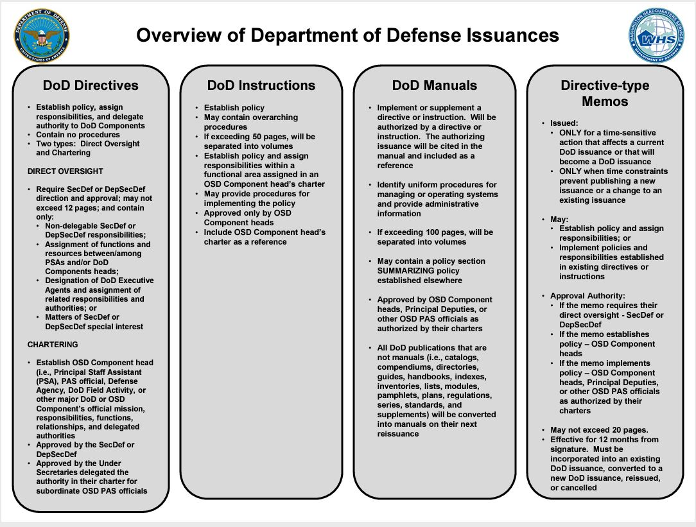

Slide 9
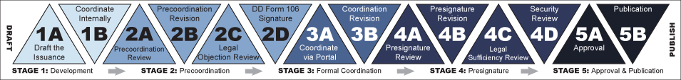
DOD Issuance Process

Slide 10
Overview of CJCS Directives
Instructions - Primarily contain CJCS/JS policy but can also include procedures. They may implement or supplement DoD Issuances, and/or establish and prescribe JS Forms. Signature level depends on subject matter and current practice.
Manuals – Primarily contain CJCS/JS procedure but can also establish policy. May supplement CJCS/JS instructions or stand alone. Signature level depends on subject matter and current practice.
Notices – Primarily contain policy, guidance, or information of a one-time or brief nature, and may include a specific effective period. Signature level depends on subject matter and current practice. In addition, there are also -
Cancellation Notices, which are used to cancel CJCS/JS Instructions, Manuals, Notices, and Guides, and expire 1 year after being published and;
Change Notices, which are used to employ small changes to CJCS/JS Directives.
Guides – Primarily contain detailed information, emphasis, and guidance from the Chairman on a specific topic, and carry a CJCS-level signature as well.
Notes:
Joint Doctrine – Does not establish policy

